Slide 1

Analysis of Smart TV Pricing and Customer Engagement on Flipkart Using Web Scraping and EDA
Presented by:
A.Vinay Reddy
Batch-456

Slide 2

Tools Used:
1)Python
2)Selenium
3)Pandas
4)Matplotlib
5)Seaborn

Slide 3
INTRODUCTION
Data analytics helps convert raw data into meaningful insights for decision-making
E-commerce platforms generate large amounts of product and customer data
Analyzing this data helps understand pricing trends and customer behavior
This project focuses on Smart TV data collected from the Flipkart platform
Web scraping is used to collect real-world e-commerce data
Exploratory Data Analysis (EDA) is applied to derive business insights

Slide 4
BUSINESS PROBLEM
Flipkart offers a wide range of Smart TVs with different brands, sizes, prices, and features
Customers find it difficult to identify value-for-money Smart TVs
Sellers lack clear insights into pricing trends and customer preferences
There is no structured understanding of how TV size affects price
Customer engagement through ratings and reviews is not clearly linked to pricing
A data-driven analysis is required to support better pricing and product decisions

Slide 5
OBJECTIVES
To collect Smart TV product data from the Flipkart website using web scraping
To clean and preprocess the scraped data for analysis
To extract key features such as brand, screen size, price, and specifications
To analyze pricing trends across different TV sizes and brands
To study customer engagement using ratings and reviews
To apply exploratory data analysis and hypothesis testing for insights
To support data-driven decision making for sellers and customers
.

Slide 6
The Dataset & Target Variable
Source: https://www.flipkart.com/search?q=smart+tv
Scope:Analysis of multiple Smart TV products listed on Flipkart across different brands, screen sizes, prices, and specifications.
Key Features
Product Information:
TV Name
Brand Name Used to compare Smart TVs from different manufacturers.
Pricing Details:Price (₹) Used to analyze pricing variations across brands and screen sizes.
Technical Specifications:
Screen Size (Inches)
Resolution (HD / Full HD / Ultra HD)
Display Type (LED / QLED / OLED)
Smart TV Availability (Yes / No)
Used to study how features influence pricing.
Customer Engagement Metrics:
Ratings Count
Reviews Count
Used to measure product popularity and customer interest.
Derived Feature:
Price per Inch (₹ per inch)
Represents cost efficiency and helps identify value-for-money TVs.

Slide 7
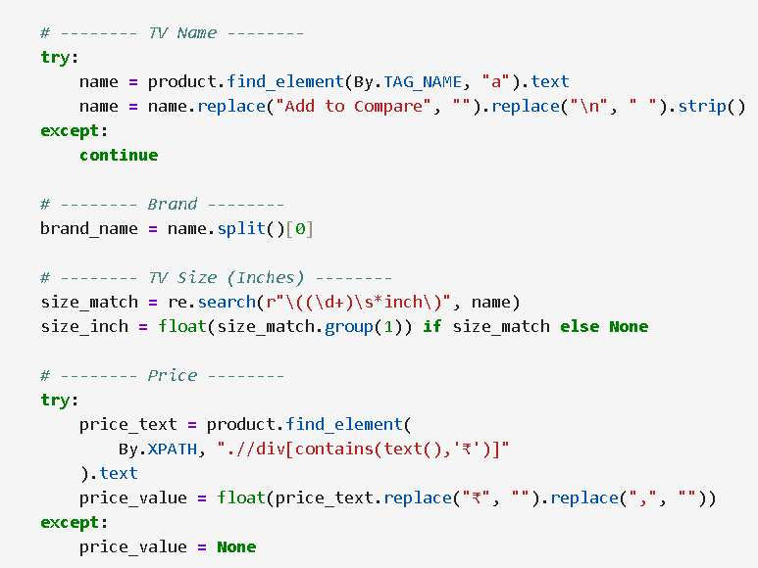
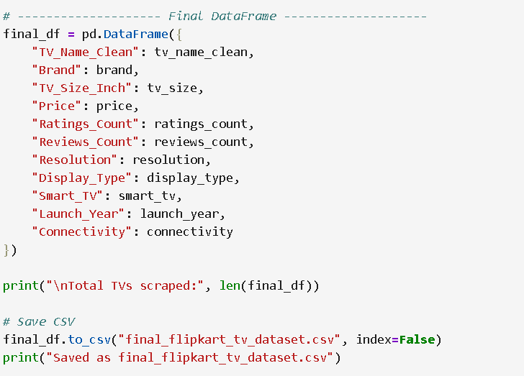
Web Scraping
Extracted Smart TV data from an online e-commerce website using Python.
Used Selenium and BeautifulSoup libraries to scrape product details from dynamic web pages.
Collected key information such as Product Name, Brand, Price, Size, and Reviews.
Cleaned and organized the scraped data by removing unwanted characters and standardizing units.
Stored the cleaned and structured data into a CSV file for further analysis.
The final dataset was prepared for Exploratory Data Analysis (EDA) to identify pricing patterns and value-for-money insights.

Slide 8
Data Cleaning Steps
Removed irrelevant text such as “Add to Compare” and extra line breaks from product names
Extracted brand name and screen size (in inches) from TV titles using string operations and regular expressions
Converted price, ratings count, and reviews count from text format to numeric values
Handled missing values by retaining non-critical nulls and removing rows with missing key attributes (price, screen size)
Standardized categorical fields such as resolution, display type, and smart TV availability
Checked for and removed duplicate product records
Created derived features like value-for-money metrics for further analysis

Slide 9
Brand Market Share Analysis
Market Leaders:
Foxsky(18.8%), Blaupunkt (8.3%), and Panasonic (7.9%) dominate the Smart TV listings on Flipkart.
Mid-Level Brands:
XIAOMI (5.8%), TCL (5.8%), PHILIPS (5.4%), and Thomson (5.0%) have a moderate market presence.
Top 3 Brands:
Together, the top three brands contribute a significant share of the total Smart TV listings, indicating strong brand dominance.
Market Structure:
The Smart TV market on Flipkart is highly competitive, with a few brands offering a wide range of models across different price segments.
Insight:
Product availability is concentrated among selected brands; however, customers should compare price, screen size, and features, not just brand popularity, to identify value-for-money Smart TVs.
compare price, screen size, and features, not just brand popularity, to identify value-for-money Smart TVs.

Slide 10
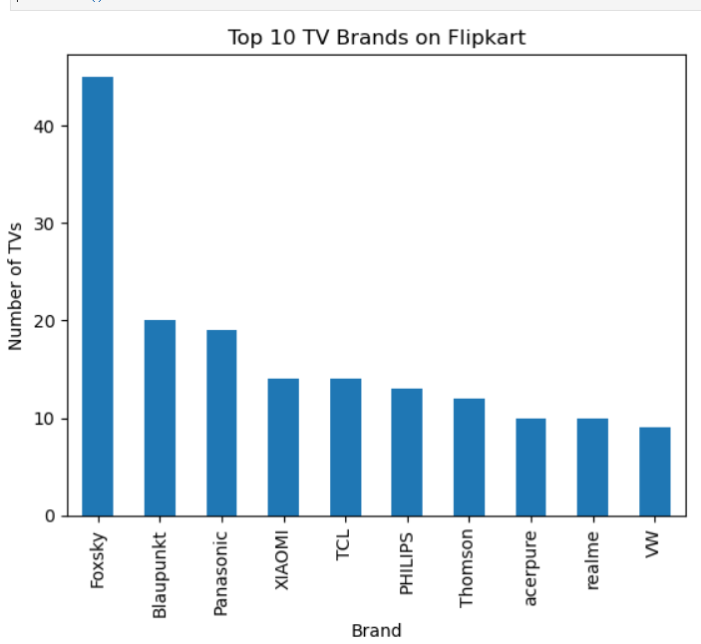
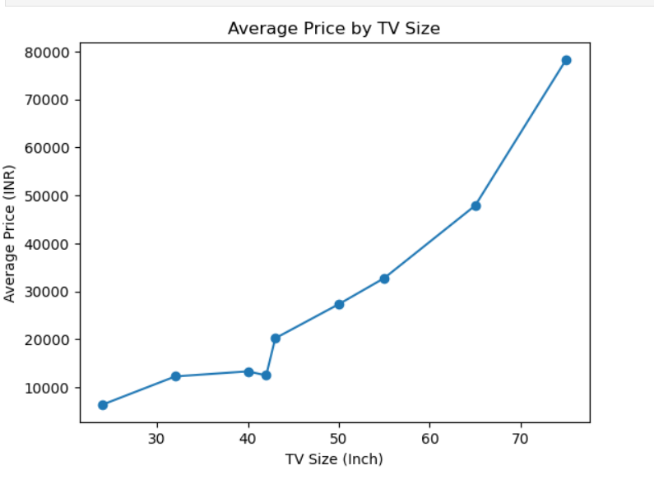
Key Performance Metrics Distribution
Price Distribution:
Shows how Smart TVs are spread across different price ranges, helping identify budget, mid-range, and premium segments.
TV Size Distribution:
Displays the frequency of different screen sizes, indicating the most popular TV sizes among customers.
Ratings Count Distribution:
Highlights how customer engagement varies across products and identifies highly popular TVs.
Reviews Count Distribution:
Helps understand customer feedback activity and validates product popularity trends.
Brand Distribution:
Shows the number of Smart TVs offered by each brand, indicating market dominance and competition.

Slide 11
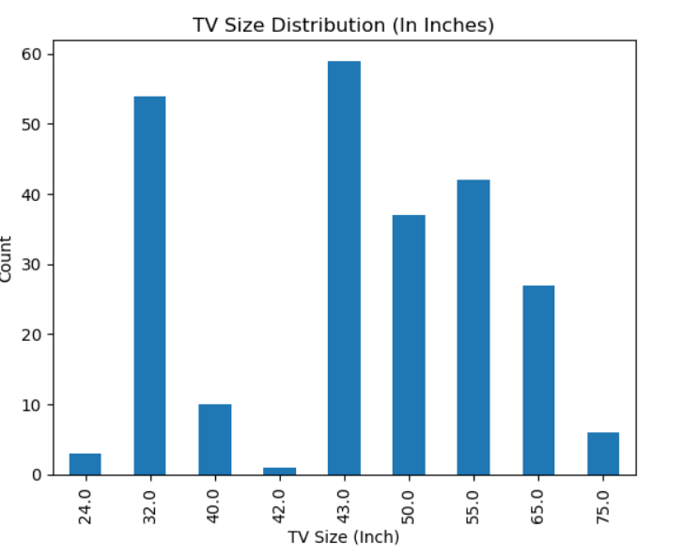
Critical Performance Relationships
TV Size vs Price:
A strong positive relationship exists, indicating that larger screen sizes are priced significantly higher.
Price vs Customer Engagement:
Price shows a weak relationship with ratings and reviews, suggesting higher prices do not guarantee higher popularity.
Ratings vs Reviews:
A very strong correlation exists, confirming that reviews reliably reflect customer engagement.
Brand vs Price:
Premium brands tend to have higher average prices, while budget brands offer competitive pricing with high engagement.
TV Size vs Engagement:
Mid-range screen sizes (32”–43”) receive higher customer interaction compared to very large or premium models.

Slide 12
Brand Performance Positioning
Market Leaders (High Volume, Mid Pricing):
Brands like Foxsky, Blaupunkt, and Panasonic dominate the market in terms of product listings, focusing on affordability and variety.
Value-for-Money Brands:
Brands such as XIAOMI, Thomson, and realme offer competitive pricing with high customer engagement, making them popular among budget-conscious buyers.
Premium Brands:
Brands like Samsung, LG, and SONY have higher average prices and fewer listings, positioning themselves as premium quality brands.
Emerging / Niche Brands:
Smaller brands focus on limited product ranges or specific price segments to compete with established players.
Customer Preference Insight:
High product availability does not always translate to higher customer engagement; pricing and features play a critical role.

Slide 13
MULTIVARIATE ANALYSIS

Slide 14
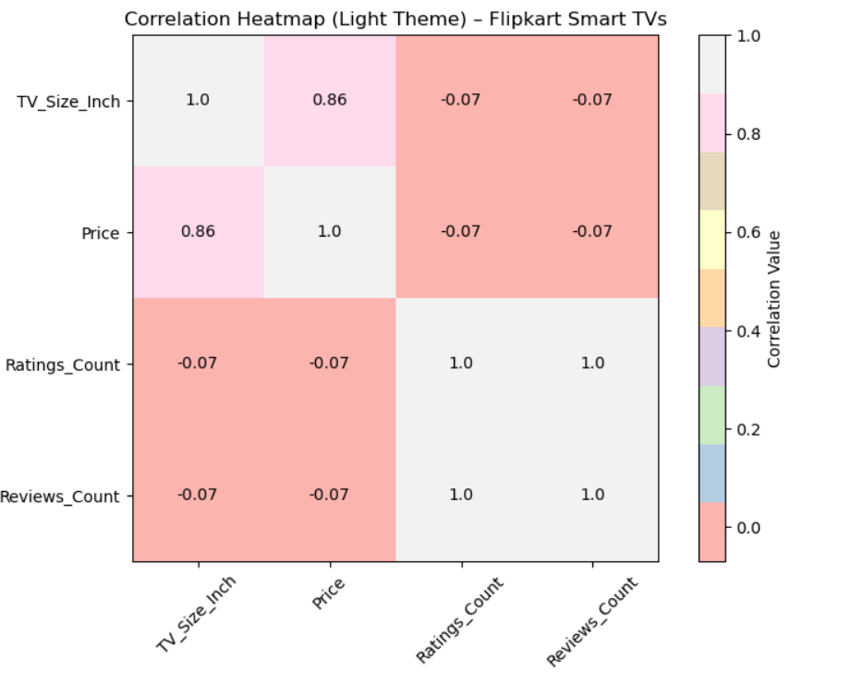
Multivariate Correlation Patterns
TV Size and Price:
A strong positive correlation is observed, indicating that Smart TV prices increase significantly with larger screen sizes.
Price and Ratings Count:
A weak negative correlation exists, showing that higher-priced TVs do not necessarily receive more customer ratings.
Price and Reviews Count:
Similar to ratings, price has a weak relationship with reviews, suggesting customer engagement is not price-driven.
Ratings Count and Reviews Count:
A very strong positive correlation is present, confirming that ratings and reviews move together as indicators of customer engagement.

Slide 15
Hypothesis Testing
Hypothesis testing is used to statistically validate insights obtained from exploratory data analysis
It helps determine whether observed relationships are significant or occurred by chance
The null hypothesis (H₀) assumes no significant relationship between variables
The alternative hypothesis (H₁) assumes a significant relationship exists
A significance level (α = 0.05) is used to make decisions
Pearson correlation test was applied for numerical variables

Slide 16
Hypothesis 1: TV Size vs Price
H₀: TV size has no significant impact on price
H₁: TV size has a significant impact on price
Result: Strong positive correlation with very low p-value
Conclusion: TV size significantly influences price
Hypothesis 2: Price vs Customer Engagement
H₀: Price has no significant effect on ratings
H₁: Price significantly affects ratings
Result: Weak correlation with p-value > 0.05
Conclusion: Price does not significantly influence customer engagement

Slide 17
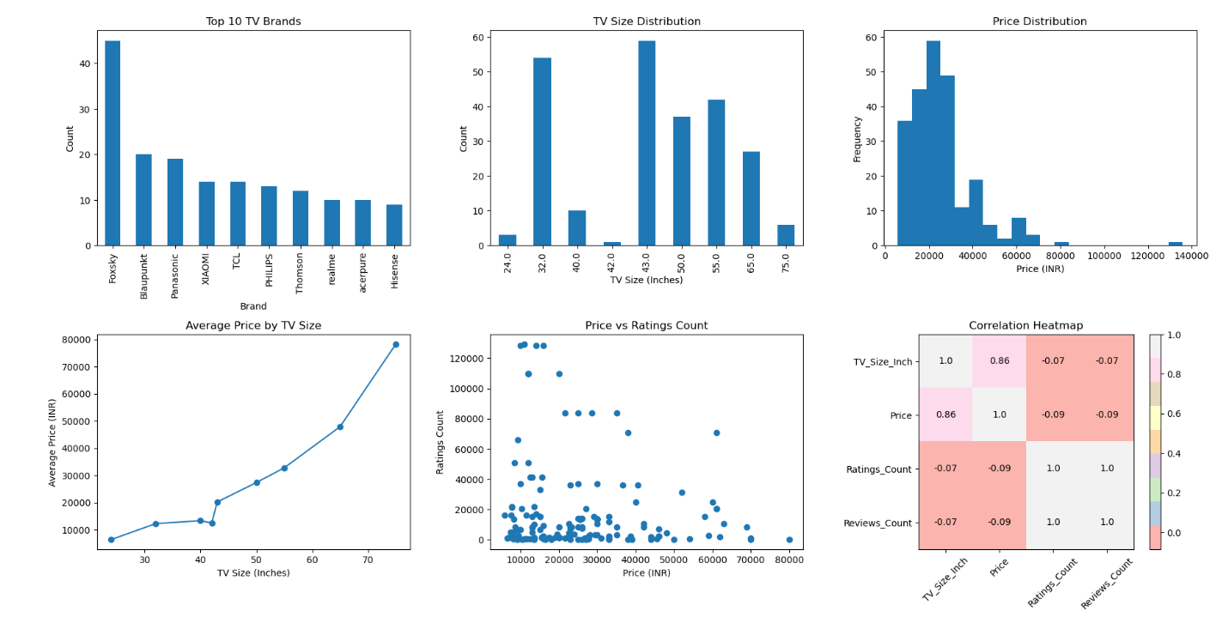
VISUALIZATION ANALYSIS

Slide 18
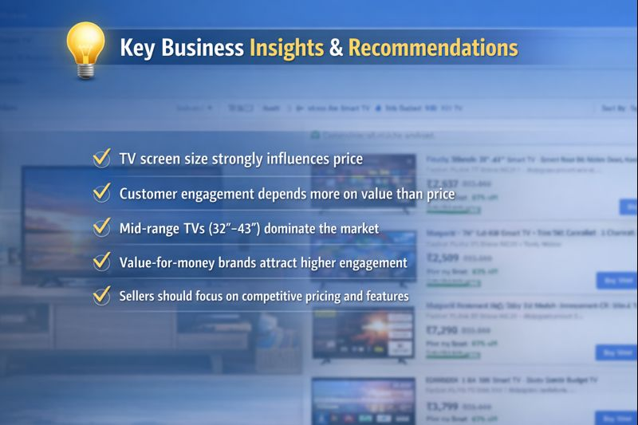

Slide 19
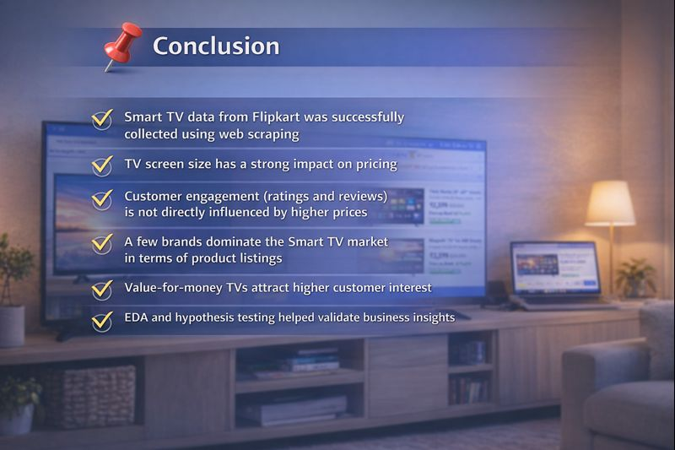

Slide 20
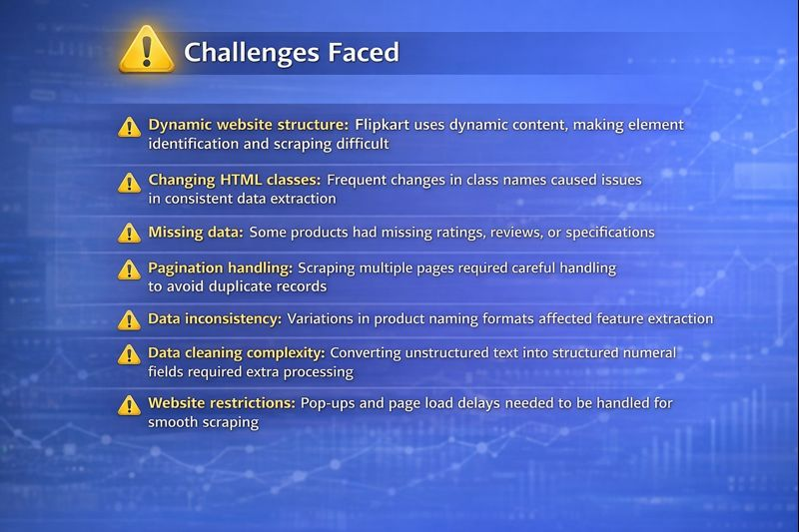

Slide 21


Slide 22


